Slide 1
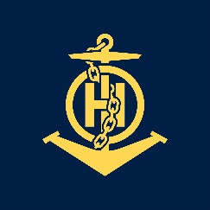
CAT B course review from a perspective of one student
IHO – NIPPON FOUNDATION
ALUMNI SEMINAR
Ante Kolić

Slide 2
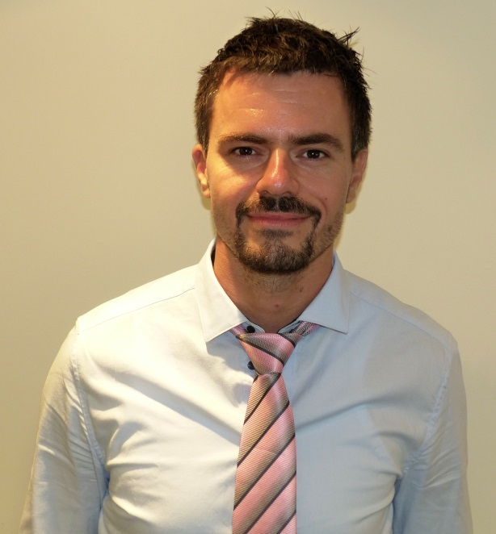
Self introduction
IHO – NIPPON FOUNDATION
ALUMNI SEMINAR
Name | Ante Kolić
Alumni year | 2018.
Country | Croatia
Organization | Hydrographic Institute of the Republic of Croatia
Position/Job title | Head of System Support/Nautical Cartographer Cartographic Department
Current job description | Analysing and control of nautical data, designing and projecting nautical chart, control and verification of data, confirmation of chart data, creating ENC cells and paper charts, working with other projects (EmodNet...), creating updates for ENC and paper charts, keeping up-to-date Croatian coastline
Please put your photo here!

Slide 3
My career path and projects / Achievements
IHO – NIPPON FOUNDATION
ALUMNI SEMINAR
Member of Croatian Cartographic Society
Member of the working group for drafting and adoption of Croatian Military Standard in the field of geoinformation (creating and establishment of AML layers and database)
Member of the working group for spatial data NSDI (National Spatial Data Infrastructure)
Technical support (creating DTM and CDI metadata sets) for project EMODnet (The European Marine Observation and Data Network)
Creation of general navigational paper chart 350-33 (Split-Pescara)
Part of the CHI team in the creation of larger scale plans -Plan 11 (Stara Savudrija, Umag, Novigrad, Piranski zaljev, Luka Mirna i Novigrad)
Successfully finished Workshop on Technical Aspects of Maritime Boundaries (November 2017, Istanbul, Turkey) organized by IHO,MBSHC, ONHO
Successfully finished course at C-MAP training for dKart Publisher (December 2017 Split, Croatia) organized by C-MAP
Successfully finished Workshop at SeaDataCloud training course (June 2018, Oostende, Belgium) organized by UNESCO/IOC
Successfully finished UKHO training course CAT B- Marine Cartography & Data Processing (September-December 2018, Taunton, United Kingdom) organized by IHO, JHA and
UKHO and sponsored by the NIPPON Foundation.
Creation of Croatian coastline in scale 1: 5 000 (usage of various fair sheets, new modern hydrographic surveys- public and private, Google Earth, Google maps, satellite imagery)
Hosting and reception of the delegation from schools, universities and various institutions
Creation of ENC cells (berthing) for the purpose of creation of new edition of „A cruising guide to the Adriatic coast of Croatia; Volume I. and II.”
Creation of paper charts for the purpose of creation of new edition of „A cruising guide to the Adriatic coast of Croatia; Volume I. and II.”
Updating paper charts and ENC with NTM on the weekly/monthly basis
Participation at the Conference of the Mediterranean and Black Seas Hydrographic Commission (MBSHC) ( June 2019, Cadiz, Spain)

Slide 4
Lessons learned from CHART Course
IHO – NIPPON FOUNDATION
ALUMNI SEMINAR
Solutions in organisation of sea names, land names and other features in paper charts
Chart typography (general information, land features, navigational aids, water features)
Database in different layers (cables, wrecks, pipelines, TSS, LOS, fish farms, MPA, PEXA, routes)
Data capture (compilation records, specification work, ENC and paper chart specs, C, V1, V2...)
5011 tests (buoy exercise, depth area...etc)
Sounding selection and creation of depth contours (triangle rule, key depths, the deeps, unexpected soundings, joining shoals)
UOOC, AC, PS, OC
a) identification of appropriate object class and acronym for different chart features
b) encoding of object shown on paper
Digital process in sounding selection (CARIS Base Editor)

Slide 5
Lessons learned from CHART Course
IHO – NIPPON FOUNDATION
ALUMNI SEMINAR
Mercator projection (+ and -)
Usage of nautical mile instead of sea mile
Accuracy and precision (1 decimal place=+/- 185 m on the ground)
Errors in the positions of objects in ENCs derived from paper charts
Positioning and plotting on the paper chart (measure bearing and distance)
a) usage of parallel, ruler and dividers
b) linear Scale and Side Border
What is a definition of a good symbol (I, D, S, S)
Symbols (10- 10, FS-fS), importance of kelp and corals
Depiction of contours and generalising shoals , „to ease depths”
Drying heights (LAT-object)
„Sounding selection is about all you leave off, not all you put in.“

Slide 6
Lessons learned from CHART Course
IHO – NIPPON FOUNDATION
ALUMNI SEMINAR
Data validation for object detection (0-40m all 2m cubic objects)
Data sources (textual and graphical, credibility...)
Performance indicators (RNW, NM, NM Block, NE...)
Navigational lights (position of the flare) (S4,B-440)
Height on nautical chart or topographic chart
Charting criteria (mariners need, scale, function)
ENC Data Set Files (New Data set, Update, Re-issue, New Edition)
Understanding polygons (Group 1 and 2)
Master-slave relationships
Dangerline values (shallowest depth contour)
Lights and light support (to determine Mandatory attributes-use chart of the largest scale or List of lights)

Slide 7
Lessons learned from CHART Course
IHO – NIPPON FOUNDATION
ALUMNI SEMINAR
text/name placement (CARIS places different!)
Cautionary notes (general, black, magenta, green)
Magnetic variation-calculate declination
Rules for Compass Placement
Source data (1/10 of chart)
International Maintaining Navigational Products (RNW, NTM B, PNTM, TNTM, UNE, NE, LTA, NA)
Work in progress in 3 years (TNM or PNM)
„Rule of thumb” for NTM (0-10=0.5m, 10-31=1.0m)
5 NM verbs used in NMs (Insert, Amend, Replace, Move, Delete) (Amend-suddenly change, Replace-on the same position, Move-inside 3cm, if it is more then 3cm-then is Insert)
Logical order in inserting positions (N to S, E to W, approaches to the harbour, along the navigational channel in direction of travel)
SCAMIN (not on buoys and beacons)

Slide 8
Suggestion for the future
IHO – NIPPON FOUNDATION
ALUMNI SEMINAR
Law of the Sea (situations related with nautical subject-maritime accidents, relation HO-ECDIS-mariners...)
Making CARIS easier to use in every HO (relation IHO-HO-Caris Teledyne)- consistency and sufficency
Creation of a guideline books among CAT B students (with tips for quicker or different solutions) for various scope of work in CARIS
After learning e-course (online quizes-apps, video conferences, engaging, connecting and empowering CAT B cartographers in different solutions which we are facing in nautical cartography- social network...)

Slide 9
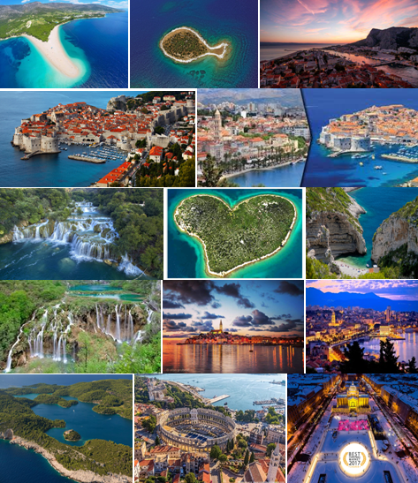
Thank you for your attention!

